Slide 1
Introduction to Data Communications and Computer Networks
CCE 211 Data Communications and Engineering
Arpita Howlader
Prof. Dr. Md. Samsuzzaman
Revised 2018-08-10

Slide 2
Reference Book
Data Communication and Networking - Behrouz A. Forouzan Latest Edition
Data and Computer Communication - William Stallings Latest Edition

Slide 3
Outline
Communications Model
Basic Data Communication Terminology
Networking
Standards Organizations

Slide 4
Telecom vs. Datacom
Communications
Transfer of data from one entity to another via some form of transmission medium
Telecommunications
Communication over a distance by definition
All type of communications using signaling such as voice (telephone), images (television), data (computers)
Data communications
Subset of telecommunications that involves the transmission and reception of data to and from computers and components of computer systems

Slide 5
Data Communication: Definition
The term telecommunication means communication at a distance.
The word data refers to information presented in whatever form is agreed upon by the parties creating and using the data.
Data Communication:
Transfer of data from one device to another via
some form of transmission medium.

Slide 6
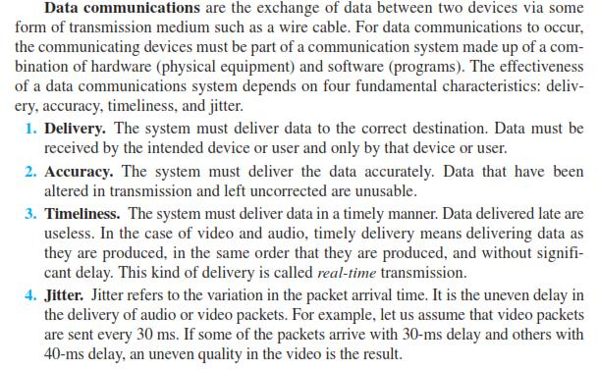
Fundamental characteristics Data Communication

Slide 7

Data Communication
Hi,
Hi,
how
how
are
are
you?
you?
Hi, how are you?
Hi, how are you?
Computer
01010001
01010001

Slide 8
Communication Model
Source system
Destination system
input message
output message
Source
Device
Destination
device
Communications
system
input data
output data
Transmitter
Transmission
medium
Receiver
transmitted
signal
received
signal
Notes:
The fundamental purpose of data communications is to exchange information between two parties. The source device generate the data to be transmitted. The transmitter transform and encodes the input data into the appropriate form of signals that can be transmitted across the transmission medium. The receiver accepts the signal and converts it into a from that can be handled by the destination device.

Slide 9
Example of Communication System
Source system
Destination system
A
A
computer
computer
Telephone Networks
110011
110011
modem
modem
Notes:
The fundamental purpose of data communications is to exchange information between two parties. The source device generate the data to be transmitted. The transmitter transform and encodes the input data into the appropriate form of signals that can be transmitted across the transmission medium. The receiver accepts the signal and converts it into a from that can be handled by the destination device.

Slide 10
Components in Communication
1
Message
Hi, how are you?
5
Protocol
2
Sender
3
Receiver
4
Medium

Slide 11
Components of Data Communications
1
Source system
2
Destination system
4
message
message
3
Source
Device
Destination
device
Communications
system
input data
output data
Transmitter
Transmission
medium
Receiver
transmitted
signal
received
signal
5
Protocol

Slide 12


1.1.2 Message -Data Representation
Numbers
8/16/32 bit integers, signed/unsigned
floating-point
Text
ASCII, Unicode
Images
Bit patterns, Graphics formats JPG, PNG, etc.
Audio → Samples of continuous signal
Video → Sequence of bitmap images
150
2
255

Slide 13
Protocols and Standards
Protocol
A set of rules governing data communications
Syntax: format of data block
Semantics: meaning of each section
Timing: speed and sequencing
Standard
De facto (in practice) standards
→ not approved but widely adopted
De jure (in law) standards
→ approved by an organization

Slide 14






Examples of Standards Organizations
List of some major standard bodies

Slide 15
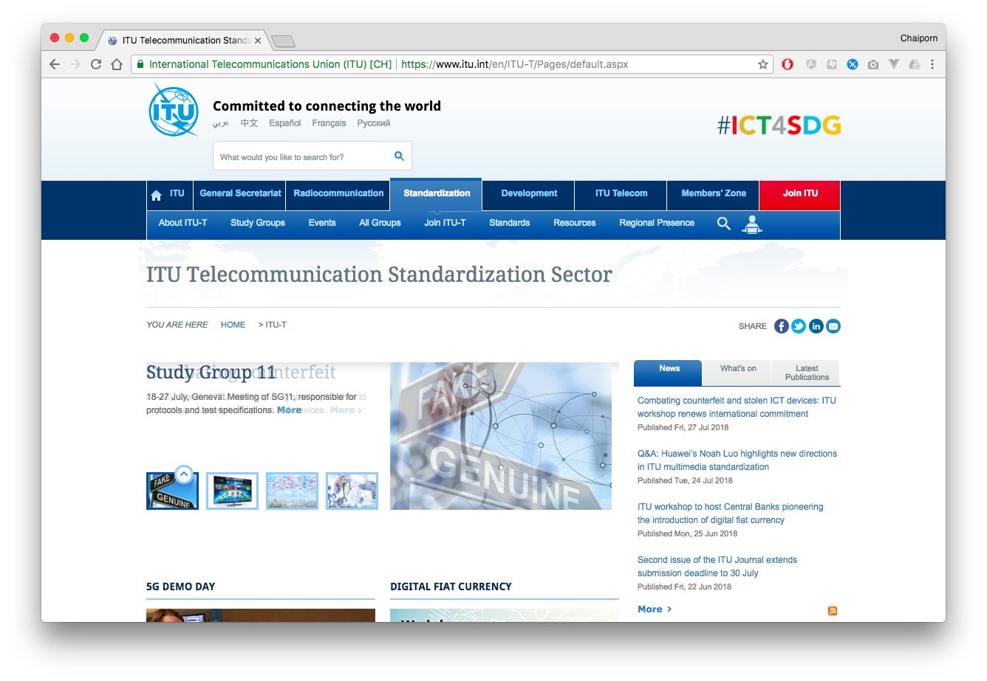
ITU-T
International Telecommunications Union – Telecommunication Standard Sector
International standard organization that develops standard for telecommunications
Some well known standards
V series
X series
H series
G Series

Slide 16

ISO
International Standards Organization
An International standard organization that develops standard for variety of fields

Slide 17

IETF
Internet Engineering Task Force
A large open international community of network designers, operators, vendors, and researchers concerned with the evolution of the Internet architecture

Slide 18
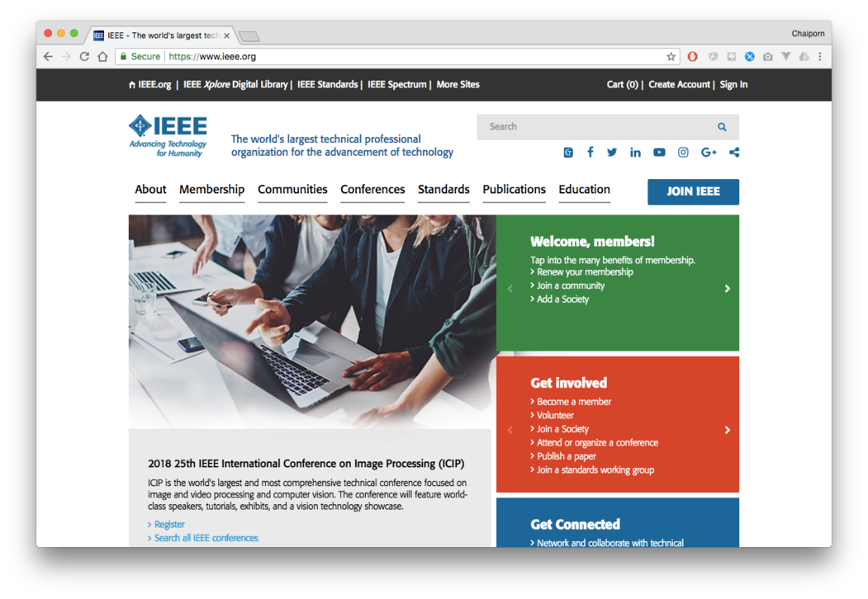
IEEE
Institute of Electrical and Electronics Engineers
The largest professional group involved in standards for computing, communications, electrical and electronics

Slide 19
Direction of Data Transmission
1.1.3 Data Flow
Simplex
Type of Direction
Half-duplex
Full-duplex
Notes:
The signal is received will differ from the signal that is transmitted due to various transmission impairments. For analog signal, these impairments cause various modifications that degrade the signal quality. For digital signal, A binary 1 may be changed into a binary 0 and vice versa due to bit error.

Slide 20
Simplex
Data are only transmitted in one direction
One device can only transmit; the other can only receive
Computer
Display
Unidirectional
Hi….
Transmitter
pager

Slide 21
Half-duplex
Both stations may transmit; but only one at a time (alternate in transmitting)
Example: Walkie-Talkies
S₁
Transmit from S₁ to S₂ at time T₁
S₂
Transmitter/Receiver
Transmit from S₂ to S₁ at time T₂
Transmitter/Receiver

Slide 22
Full-duplex
Full-Duplex operation can occur in two ways:
two separate transmission path
channel is divided between signals traveling in opposite directions
Example: telephones
Simulteneous send and receive
data from each other
S₁
S₂
Transmitter/Receiver
Transmitter/Receiver

Slide 23


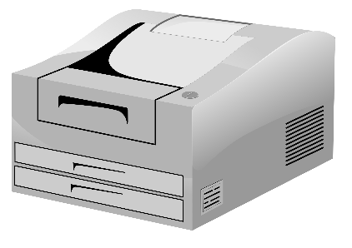
Networks
A network is a set of two or more devices connected through a communication system
Communication System
Cliparts are taken from http://openclipart.org

Slide 24
Network Criteria
A network must be able to meet a certain number of criteria. The most important of these are
performance,
reliability, and
security.

Slide 25
Line Configurations
Physical Structures
Point-to-Point
Line configurations
Multipoint
Type of Connection
A network is two or more devices connected through links. A link is a communications pathway that transfers data from one device to another. For communication to occur, two devices must be connected in some way to the same link at the same time.

Slide 26
Point-to-Point
Only two devices share the medium
The entire capacity of the link is reserved for the transmission between those two devices
A direct link
between two devices
A direct link
between two devices
Station
Station

Slide 27
Multipoint (or Multidrop)
More than two devices share the same medium
The capacity of the link is shared
Station
Station
Station
A link is shared
between several devices
Station
Station

Slide 28
Data Transmission
Parallel
Data Transmission
Serial
Asynchronous
Synchronous

Slide 29
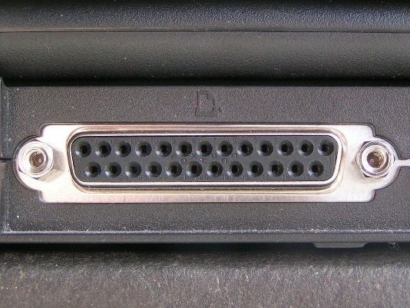
Parallel Transmission
Simultaneous transmission results in high speed
Required more data lines, hence higher cost
Usually limited to short distances because its costs and crosstalk
0
1
0
1
1
0
1
1
Need eight data lines
for sending each byte
Picture from Wikipedia

Slide 30
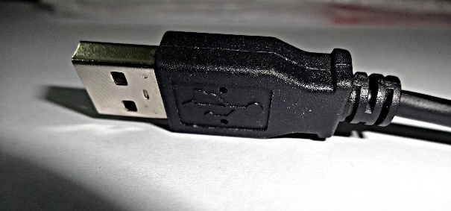
Serial Transmission
One bit follows another, only one data line for each direction
The sender needs a parallel-to-serial converter and the receiver needs a serial-to-parallel converter.
A group of bits are sent one after another
0101101110
0100101110
0000101110
0110101110
Need only one data line

Slide 31
Network Topologies
Common topologies are bus, ring, star, and mesh
Network Topologies
Bus
Star
Mesh
Ring

Slide 32
Topology
Topology: physical or logical arrangement of devices
Point-to-point
Mesh
Star
Bus
Ring
Hybrid

Slide 33
Point-to-Point Connection

Slide 34
Fully Connected Mesh Topology
E
A
D
B
C

Slide 35
Fully Connected Mesh Topology

Slide 36
Fully Connected Mesh Topology
Pros:
Dedicated links
Robustness
Privacy
Easy to identify fault
Cons:
A lot of cabling
I/O ports
Difficult to move

Slide 37
Star Topology
A
D
Hub
Drop
B
C
Drop

Slide 38
Star Topology
A
D
Switch
B
C

Slide 39
Star Topology
A
D
Hub
B
C

Slide 40
Star Topology
Pros:
One I/O port per device
Little cabling
Easy to install
Robustness
Easy to identify fault
Cons:
Single point of failure
More cabling still required
Hub

Slide 41
Bus Topology
Drop line
Tap
Terminator

Slide 42
Bus Topology
A
B
C
D

Slide 43
Bus Topology

Slide 44
Bus Topology
Pros:
Little cabling
Easy to install
Cons:
Difficult to modify
Difficult to isolate fault
Break in the bus cable stops all transmission

Slide 45
Ring Topology
C
D
B
A

Slide 46
Ring Topology

Slide 47
Ring Topology
Pros:
Easy to install
Easy to identify fault
Cons:
Delay in large ring
Break in the ring stops all transmission

Slide 48
Hybrid Topologies

Slide 49
Switching Networks
Communication Network Node
provide switching facility (routing)
Network Station
end node (source &destination)
Communications is achieved by transmitting
data from source to destination through a
network of switching nodes
Communication Network

Slide 50


Switching Technologies
Circuit switching
A circuit is established for the two parties
Packet switching
Data are put into packets, each stamped with source and destination addresses
Routers know where to forward packets
telephone switch
Packet
Router

Slide 51
Key Differences
Aspect | Circuit Switching | Packet Switching
Data path | Dedicated single route | Different shared routes
Message | Bypass | Temporarily stored at each node
End point's status | Both must be ready | Only sender is ready
Utilization | Poor | Good
Data rate | Fixed | Varied
Prioritization | Not support | Support

Slide 52
Network Categories by Distance
Network categories (by distance)
Local Area Network (LAN)
Wide Area Network (WAN)
Body/Personal Area Network (BAN/PAN)
Metropolitan Area Network (MAN)
Notes:
The signal is received will differ from the signal that is transmitted due to various transmission impairments. For analog signal, these impairments cause various modifications that degrade the signal quality. For digital signal, A binary 1 may be changed into a binary 0 and vice versa due to bit error.

Slide 53
LAN
hub/switch
stations
General Characteristics :
Confined geographical area
Under single management
High data rate
hub/switch
stations
hub/switch
stations
servers
hub/switch
router
Notes:
Communications network that serves users within a confined area is known as a Local Area Network (LAN). Computers (server and workstations) are normally distributed around a single office or building, including network device like hub, bridge or router.

Slide 54
MAN
A network which cover an entire city
A single network or a number of connected LANs
LAN
LAN
Public city
network
LAN
LAN
Notes:
Data communication takes place between two devices that are connected. It is impractical for any two devices to be directly, point-to-point connected because of :
- The devices are very far apart.
- Some device may require a link to many of the others.
The solution is to attach each device to a network. The devices are known as stations or network stations. The stations may be computer or other communicating devices. Each station attaches to a network node, which performs communication tasks.
เครือข่ายโทรศัพท์สาธารณะ (Public Switched Telephone Network : PSTN)
แลน (Local Area Network : LAN)
สายเช่า (Leased lines)
เครือข่ายข้อมูลสาธารณะ (Public Switched Data Network : PSDN)
เครือข่ายบริการร่วมดิจิตัล (Integrated Services Digital Network : ISDN)

Slide 55
WAN
A network that covers a relatively broad geographic area
It often uses long-distance transmission facilities provided by public carriers

Slide 56


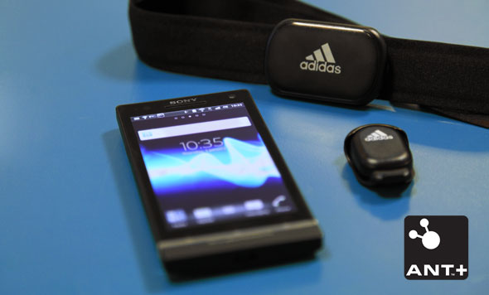
BAN/PAN
Nike.com
https://www.bhphotovideo.com/images/images1000x1000/Adesso_IMOUSE_S100_Bluetooth_Mini_Optical_Scroll_696816.jpg
http://developer.sonymobile.com

Slide 57
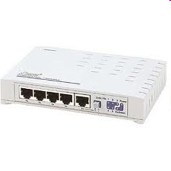
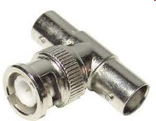
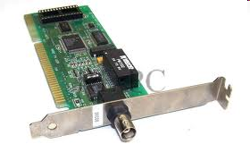
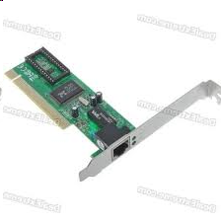
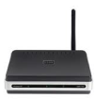
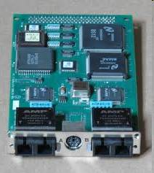
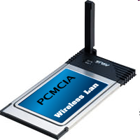
Network of Networks
Company A
Company B
Network Interface Card (NIC)
Company C
Company D

Slide 58
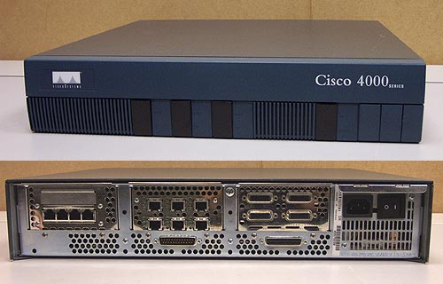

Internetworking
How to allow devices of different standards to communicate?
Gateways/routers – devices capable of communicating in several standards
These become "network of networks", i.e., internetwork

Slide 59
Internetworks
Collection of networks interconnected by routers and other devices
LAN
LAN
WAN
LAN
LAN
LAN
MAN

Slide 60
The Internet
The largest internetwork in the world
Devices communicating with TCP/IP protocol suite
Stanford
U. of Utah
UC Santa Barbara
UCLA

Slide 61
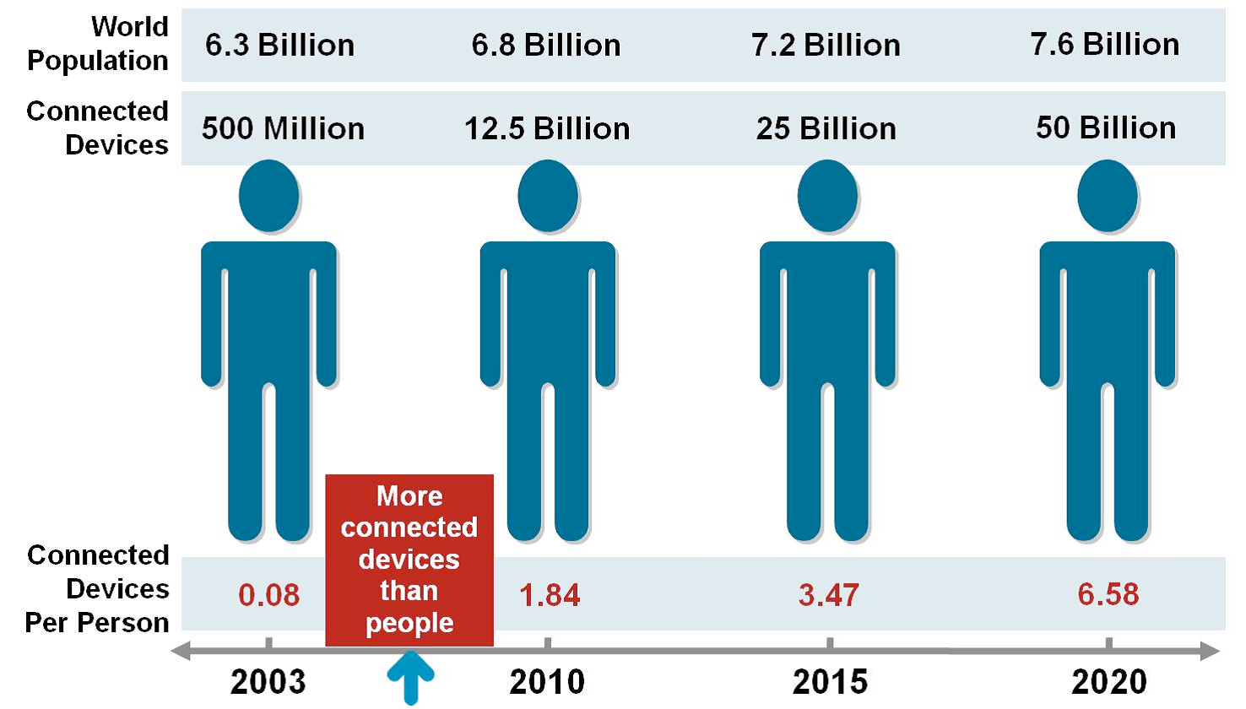
Internet Growth
https://devcentral.f5.com/articles/security-sidebar-defending-the-internet-of-things

Slide 62
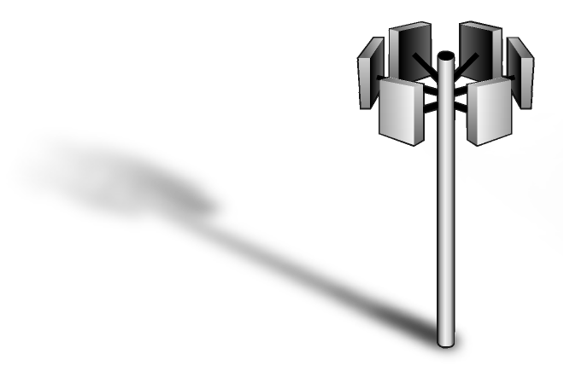

Technologies Around Us
New generation of switching technologies provide improved services to home and workplace
Cable Modem
Frame Relay
Network
ADSL
CATV
Internet
ATM
Network
Cellular 3G/4G/5G
ISDN
Network
E/T-carrier
PSTN
Network
Modem
Notes:
Public carrier circuit have been normally used for connected computers in different sites,. The resulting network is known as a Wide Area Network (WAN). One approach is to lease transmission lines from the public carriers and install a private switching system at each site to create an Enterprise Wide Private Network. Such networks normally incorporate both voice and data communications.
The benefits are such as communication channel is private and online, several data transmission rate is provided from low speed to high speed.

Slide 63
Summary
Data communications
Protocols and standards
Data flows
Connectivity
Computer networks
Topologies
LAN/MAN/WAN/BAN/PAN
Internetworks (networks of networks)
The Internet

